Slide 1
Product & Planning
3AGIL - Day 2

Slide 2
Course Summary
Product Ownership (45’)
Product Vision & strategy (3h)
User Stories & Priorisation (2h)
Planning Poker (1h)
Knowledge Check (15’)

Slide 3
Product Ownership

Slide 4
What is product ownership ?
“Defining, prioritizing, and communicating the features and capabilities of a product to ensure that it meets the needs and expectations of customers and stakeholders.”
Critical in agile development methodologies because it helps to ensure that the product is delivered on time, to a high quality, and with maximum value to the customer.

Slide 5
Role of a Product Owner
The product owner is responsible for representing the interests of the customer and setting the strategic direction for the product.
This includes :
defining the product vision, roadmap, and release plan,
prioritizing the product backlog to ensure that the most valuable features are delivered first.

Slide 6
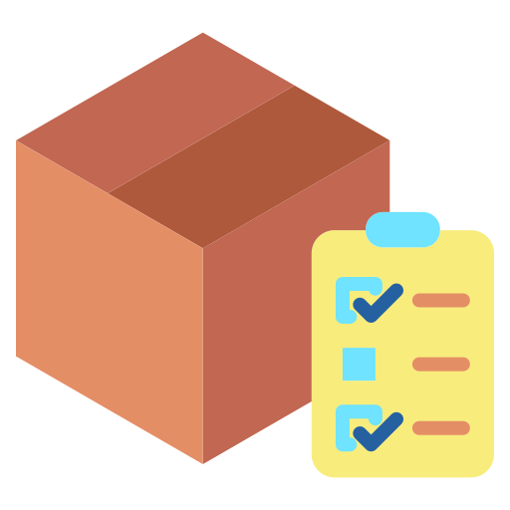
Responsibilities of a PO
Define and communicate the product vision
Prioritize and manage the product backlog
Collaborate with cross-functional teams
Communicate progress and updates to stakeholders
Notes:
Define and communicate the product vision: helps define the long-term vision and strategy for the product, and communicating this vision to stakeholders and cross-functional teams.
Prioritize and manage the product backlog: prioritizing the features and capabilities that will be included in the product, based on the value they will provide to the customer and the business.
Collaborate with cross-functional teams: works closely with design, engineering, QA, and other teams to ensure that the product is delivered on time and to a high quality.
Communicate progress and updates to stakeholders: responsible for keeping stakeholders informed of progress on the product, and for managing expectations around timelines and deliverables.

Slide 7
Product Owner vs. Project Manager ?
Product owners are responsible for defining the product vision and strategy, and for prioritizing and managing the product backlog.
Project managers are responsible for planning and executing projects, and for managing resources and budgets to ensure that projects are completed on time and within scope.
Both product owners and project managers need strong leadership, communication, and problem-solving skills, but they have different areas of focus and responsibility.

Slide 8
Product vision & strategy

Slide 9
Defining the product vision
“A product vision provides a long-term direction for the product and helps to align stakeholders and cross-functional teams around a common goal.”
Steps for defining the product vision:
  Identify the target market and customer needs
  Determine the value proposition
  Define the product vision statement
Notes:
Identify the target market and customer needs: Start by understanding the needs and pain points of your target market, and what they are looking for in a product.
Determine the value proposition: Next, define the unique value that your product will offer to customers, and how it will solve their needs and problems.
Define the product vision statement: Use this information to create a clear and concise statement that captures the essence of your product and its value proposition.

Slide 10
Product Roadmap
A product roadmap is a high-level overview of the features and capabilities that will be included in the product over time. It helps to align stakeholders and cross-functional teams around a common vision and provides a clear direction for development.
Steps for developing a product roadmap:
  Define the long-term goals and objectives for the product: What do you want to achieve with the product, and how will it benefit the customer and the business?
  Break down the goals into smaller, more manageable chunks: Divide the long-term goals into smaller, more achievable objectives that can be accomplished over shorter time periods.
  Prioritize the objectives: Determine which objectives are most important and should be tackled first, and which can wait for future releases.

Slide 11
Priorisation
Prioritization is critical in product development because it helps to ensure that the most valuable features are delivered first and that resources are used efficiently.
Techniques for prioritizing the product backlog:
  Value vs. effort matrix: Plot each feature on a matrix based on its value to the customer and the effort required to implement it. This can help to prioritize features based on their potential impact and feasibility.
  Kano analysis: This technique involves grouping features into categories based on how they affect customer satisfaction. High-impact features (such as "delighters") should be prioritized over lower-impact features (such as "must-haves").
  MoSCoW method: This method involves prioritizing features as "must-haves," "should-haves," "could-haves," or "won't-haves" based on their importance and feasibility.

Slide 12
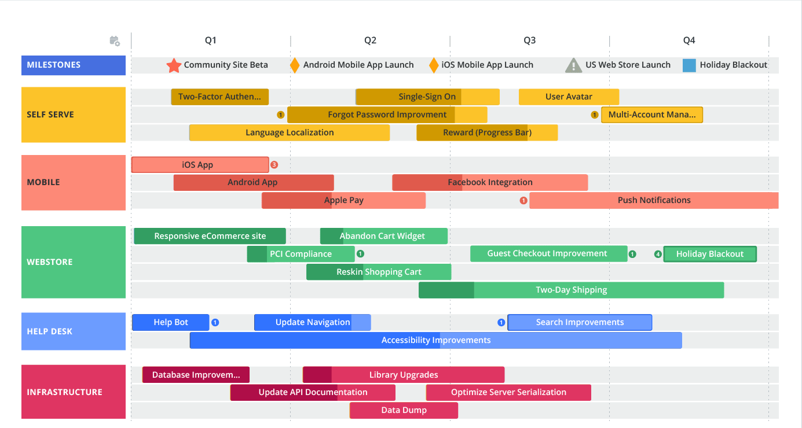
What does it look like ?

Slide 13
Exercise time (1h30’) - Groups of 3-5
Choose an app / product / website you know quite well (ex : AirBnb, Instagram, Lydia, etc.)
Follow the steps for creating a roadmap :
  Define the long-term goals and objectives for the product: What do you want to achieve with the product, and how will it benefit the customer and the business?
  Break down the goals into smaller, more manageable chunks: Divide the long-term goals into smaller, more achievable objectives that can be accomplished over shorter time periods.
  Prioritize the objectives: Determine which objectives are most important and should be tackled first, and which can wait for future releases.
Build the roadmap !
Notes:
Student can use Powerpoint, Lucidchart or Diagram.net to drawn their roadmap.
Have them understand the correct level of breakdown needed at roadmap level : not too detailed, not technical yet : focused on features and business value

Slide 14
User Stories & Priorisation

Slide 15
What are user stories ?
User stories are short, simple descriptions of a feature or capability from the perspective of the user. They are used in agile development methodologies to capture the requirements for a product and to help guide development efforts.
Usual format : As a [user], I want [feature or capability], so that [benefit].
Acceptance criteria: A set of specific, measurable criteria that must be met in order for the user story to be considered complete.

Slide 16
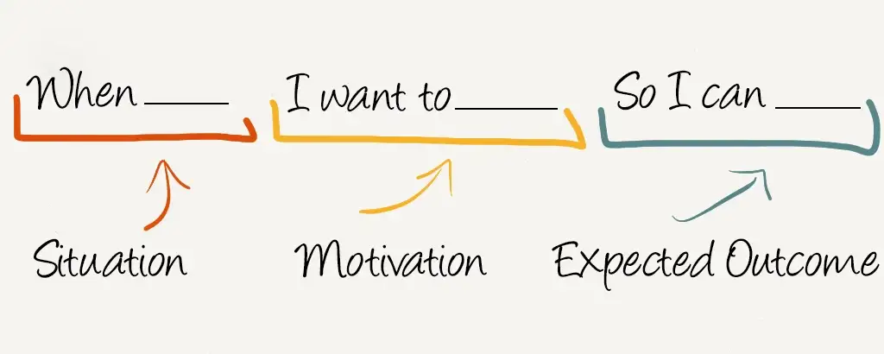
(Read)(20’) Alternative : the Job Story
Notes:
Share this link to your students and have them read this : https://jtbd.info/replacing-the-user-story-with-the-job-story-af7cdee10c27

Slide 17
Benefit of User stories
User stories help to focus on the needs and goals of the user, rather than on technical details.
User stories facilitate collaboration and communication between product owners, developers, and other stakeholders.
User stories provide a flexible and adaptable way to capture and prioritize requirements.

Slide 18
Tips on writing User Stories
Make sure the user story is clear and concise.
Make sure the user story has a clear value proposition for the user.
Make sure the acceptance criteria are specific and measurable.
Use examples and scenarios to illustrate the user story.
Collaborate with cross-functional teams to ensure that the user story is feasible and can be implemented in the given time frame.

Slide 19
Definition of done
Set of specific criteria that must be met in order for a user story or product feature to be considered complete.
List of key components that may be included in the definition of done:
Code has been reviewed and is of high quality.
Unit tests and automated tests have been created and run successfully.
User documentation has been created and reviewed.
Feature has been tested by the QA team and any issues have been resolved.
Feature has been reviewed by the product owner and stakeholders and has received approval for release.
Notes:
Definition of done can be different from team to team !

Slide 20

Product backlog
Prioritized list of features, capabilities, and enhancements that are planned for a product.

Slide 21
Example of Product Backlog
Priority | Sprint | Complexity | User Story
P0 | 1 | 8 | As a user, I want to be able to view a feed of user-generated content, including photos and videos, so that I can discover new and interesting content.
P0 | 1 | 5 | As a user, I want to be able to follow other users and view their content in a single feed, so that I can keep up with the content that I am interested in.
P0 | 1 | 3 | As a user, I want to be able to like and comment on posts, so that I can interact with the content and the community.
P0 | 2 | 5 | As a user, I want to be able to search for other users and specific hashtags, so that I can find and connect with people and content that interests me.
P0 | 2 | 8 | As a user, I want to be able to create and manage my own profile, including the ability to add a profile picture and bio, so that I can represent myself on the app.
P1 | 2 | 8 | As a user, I want to be able to edit and filter my photos, so that I can improve their appearance and share them more effectively.
P1 |  | 5 | As a user, I want to be able to tag other users in my posts, so that I can credit them and share content with them.
P1 |  | 16 | As a user, I want to be able to direct message other users, so that I can communicate with them privately.

Slide 22
Exercise (1h+) - Same Groups
Go back to your previously created roadmap.
Break down each roadmap blocks into features (try to get about 30-40 features)
For each feature, write its user story / job story (your choice)
While doing so : organise your work as a maintainable product backlog. (Choose your tools carefully :) )
Write your own Definition of Done, based on your product’s need and your own experience.

Slide 23
Planning Poker
Planning poker is a method for estimating the effort required to complete user stories or tasks in an agile development process.
Each player is given a deck of cards with numbers representing different levels of effort, such as 0, 1, 2, 3, 5, 8, 13, 20, 40, or 100.
The product owner or facilitator presents a user story or task and each player selects a card to represent their estimate of the effort required to complete it.
The players reveal their cards at the same time and discuss any discrepancies in their estimates.
If there is disagreement, the players can discuss and re-estimate until they reach a consensus.
Once a consensus is reached, the final estimate is recorded and the process is repeated for the next user story or task.

Slide 24
Planning poker best practices
Involve the right people
Clearly define the user story or task
Use relative estimation
Encourage open discussion and collaboration
Avoid anchoring
Use a facilitator
Notes:
Involve the right people: Make sure to include all relevant stakeholders in the planning poker session, such as product owners, developers, and QA team members.
Clearly define the user story or task: Make sure that the user story or task being estimated is clearly defined and understood by all participants.
Use relative estimation: Rather than trying to come up with an exact estimate, use the cards to compare the relative size and complexity of the user story or task to others.
Encourage open discussion and collaboration: Encourage participants to ask questions and share their reasoning behind their estimates. This can help to identify any misunderstandings or assumptions and improve the accuracy of the estimate.
Avoid anchoring: Avoid letting one person's estimate influence the others. Encourage each participant to come up with their own estimate independently.
Use a facilitator: Consider having a facilitator to lead the planning poker session and ensure that it runs smoothly and efficiently.

Slide 25
Other method of complexity evalutation
Affinity estimation: This method involves grouping user stories into categories based on their complexity and size, and then assigning an approximate estimate to each category.
Expert judgment: This method involves asking an expert or subject matter expert to evaluate the complexity of a user story based on their knowledge and experience.
Three-point estimation: This method involves breaking down the user story into smaller tasks and estimating the effort required for each task. The final estimate is then calculated as the average of the estimates for the individual tasks.
Story points: This method involves assigning a certain number of points to each user story based on its complexity and size, and then estimating the effort required to complete the story based on the number of points assigned.

Slide 26
Exercise : Planning Poker (45’-1h+) - Same Groups
Run a planning poker through your product backlog.
Take the time to discuss : it may take more than 5’ for each task !
Once you have identified the complexity of your user stories, review your prioritization : is it still relevant ? What would you change ?

Slide 27
Minimum Viable Product
The MVP is a product with just enough features to satisfy early customers and provide valuable feedback for future development.
It is a way to test a product hypothesis with the least amount of effort and resources.
The MVP allows for rapid prototyping and iteration based on customer feedback.
The MVP helps to minimize risk by allowing the team to gather valuable data and insights before committing significant resources to a full product.
The MVP can help to focus development efforts on the most valuable and necessary features, rather than trying to build everything at once.

Slide 28
What to include in a MVP ?
Identify the core value proposition
Prioritize based on customer needs
Consider feasibility
Balance risk and reward
Gather feedback
Notes:
Identify the core value proposition: What is the unique value that your product will offer to customers, and how will it solve their needs and problems? Focus on the features that are most critical to delivering this value.
Prioritize based on customer needs: Consider what features and capabilities are most important to your target customers and prioritize those in the MVP.
Consider feasibility: Make sure that the MVP is feasible to build within the given time and resources.
Balance risk and reward: Consider the potential impact and benefit of each feature, as well as the risk and effort required to implement it. Focus on the features that offer the most value with the least risk.
Gather feedback: Engage with customers and stakeholders early in the process to gather feedback and validate your assumptions about what should be included in the MVP.

Slide 29
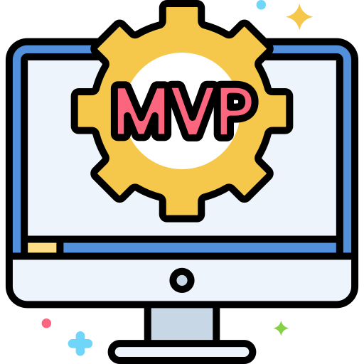
Exercise : MVP proposition (30’) - Same Group
Identify your MVP in your product backlog
Build a 5 slides deck presenting your MVP to investors

Slide 30
Knowledge Check (10’)

